Slide 1

Introduction to JSON

Slide 2
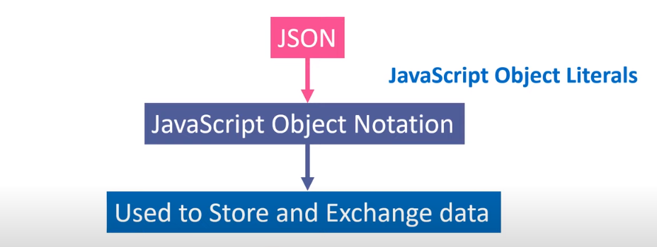
What is Json?

Slide 3
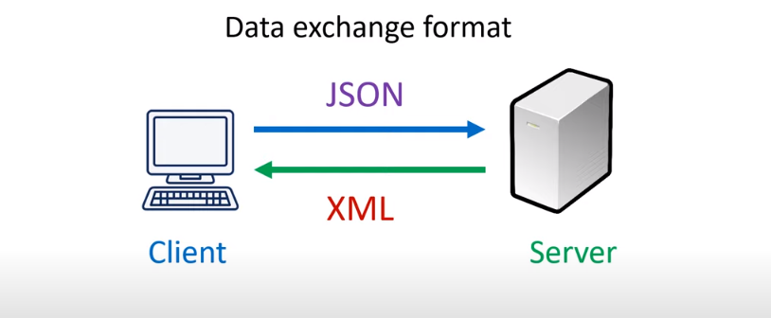
When to use Json?

Slide 4
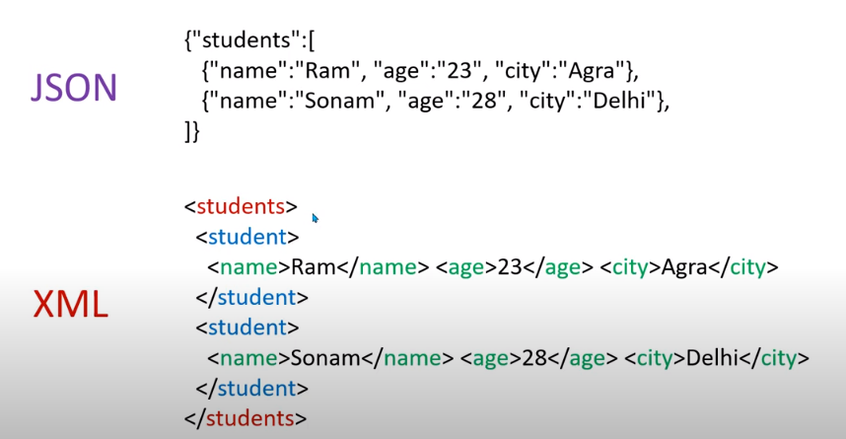
Data formet of Json to xml?

Slide 5
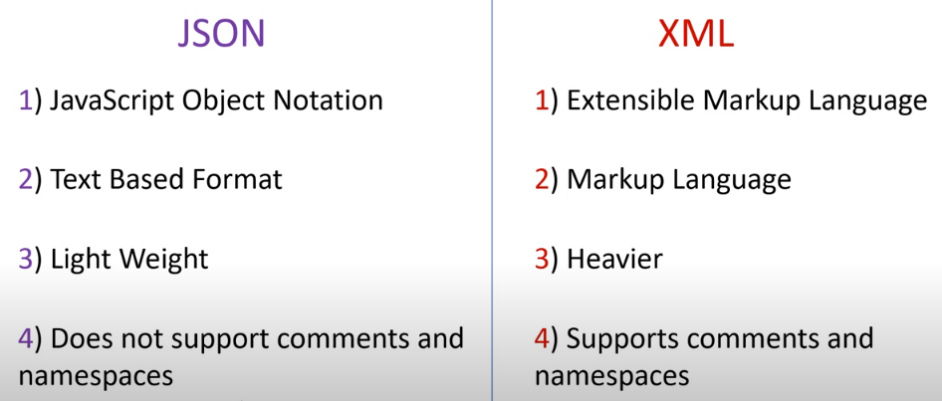
Deference between JSON & XML ?

Slide 6
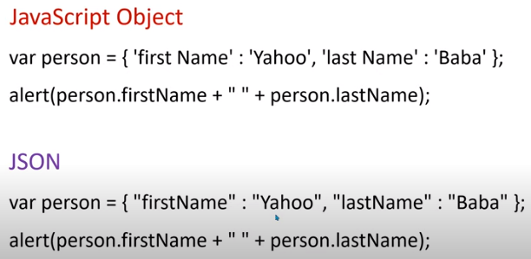
Javascript Object literals &JSON?
Var Person ={ first Name : ‘Summaiya’ , last Name : ‘Aslam’ };
Alert (person.firstName + “” + person.lastName);
Var Person ={ “first Name” : “Summaiya” , “last Name” : “Aslam” };
Alert (person.firstName + “” + person.lastName);

Slide 7
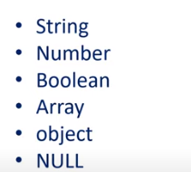
Data Type allowed in JSON?

Slide 8
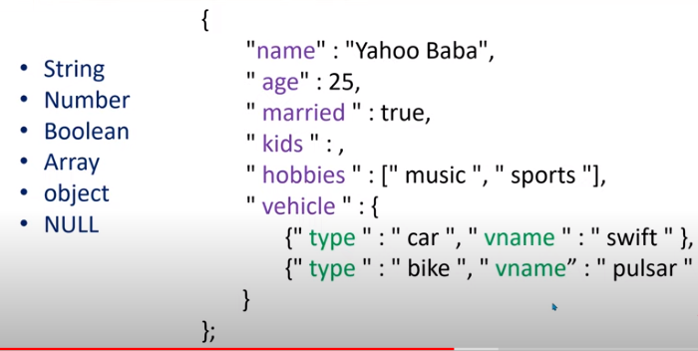
Data Type allowed in JSON?
}

Slide 9
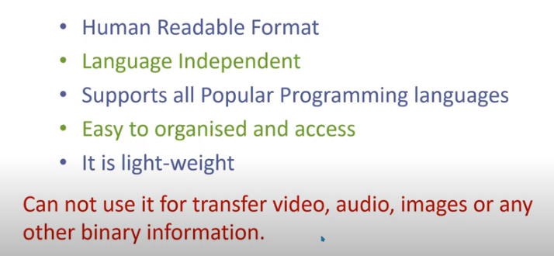
Advantages of JSON?
}

Slide 10
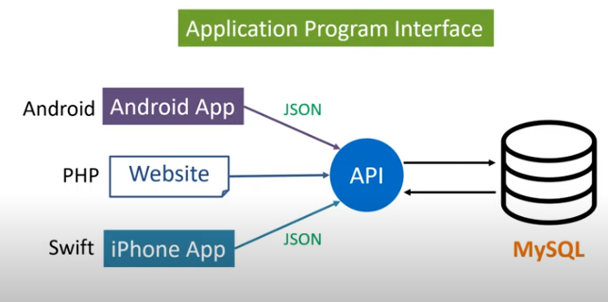
What is APIs (Application Programming Interfaces)?

